Slide 1

Text Mining Program Demo
Yang Zhou (G1700594D)
Zeng Jiameng (G1700624J)
Sun Qianqian (G1700670L)
Saumya Agarwal (G1702632H)
Wang Yanhang (G1700683L)
By powerpuff girls

Slide 2
Outline
Introduction
Pre-processing
Sentiment Analysis
Topic Modelling

Slide 3
1.
Introduction

Slide 4
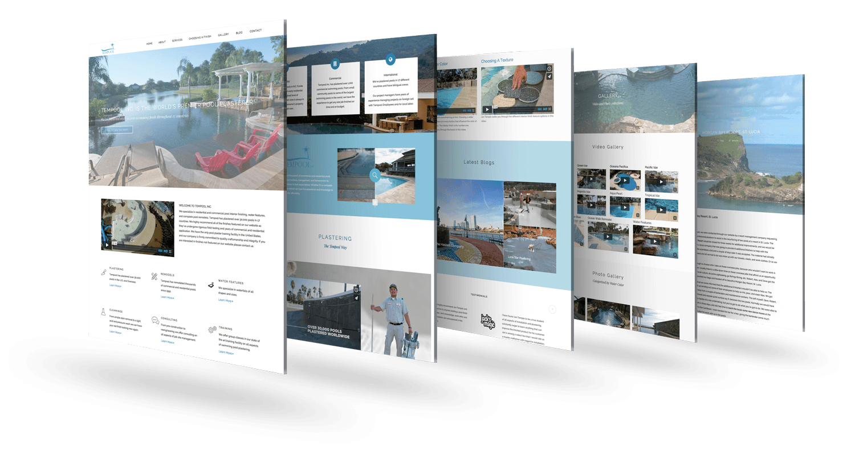


What is text mining ?
Ability to approach the unstructured text
Process of understanding information and find out valuable knowledges

Slide 5
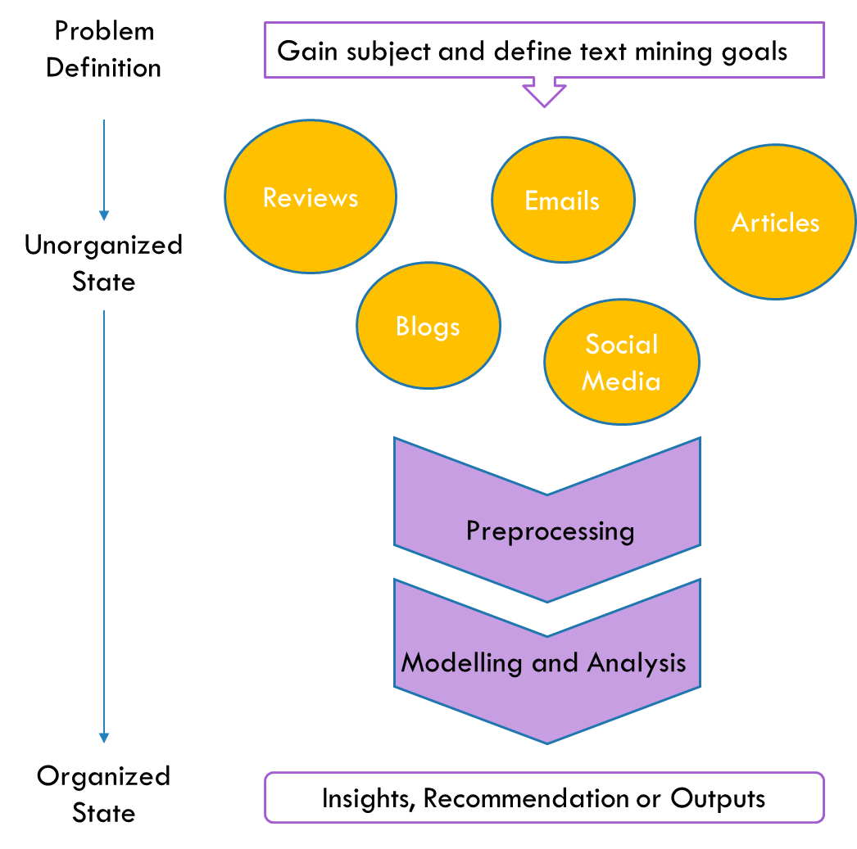
Overview of process
Importing
String operations and pre-processing
Creating the document-term matrix
Filter and weight the terms in the DTM
Sentiment analysis
Topic Modelling

Slide 6
Two approaches
Sentiment Analysis
identifying and determine whether the writer's attitude towards a particular topic or product is positive, negative, or neutral.
Supervised (Classification model)
Unsupervised (Dictionary-based)
Topic Modelling
discovering the abstract "topics" that occur in a collection of documents.

Slide 7
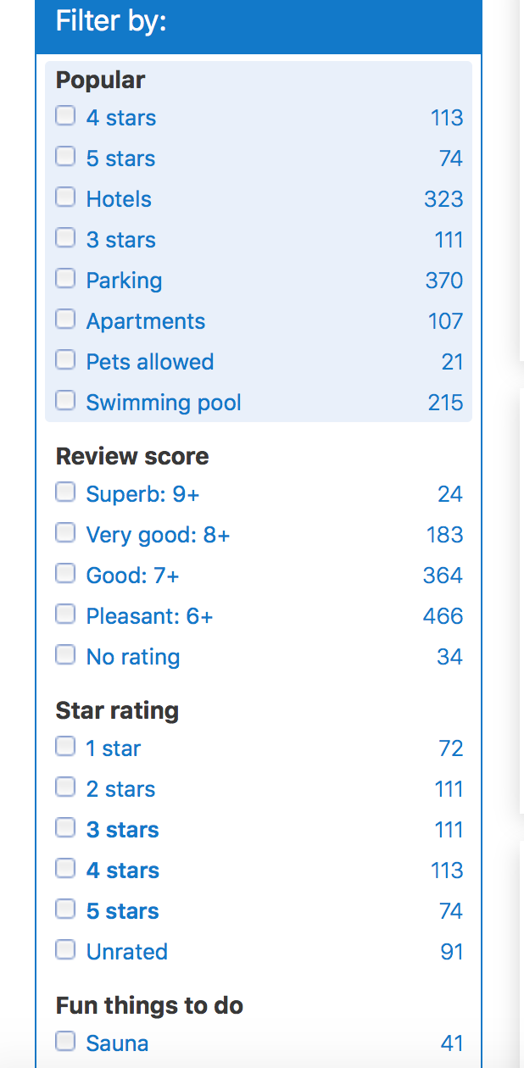
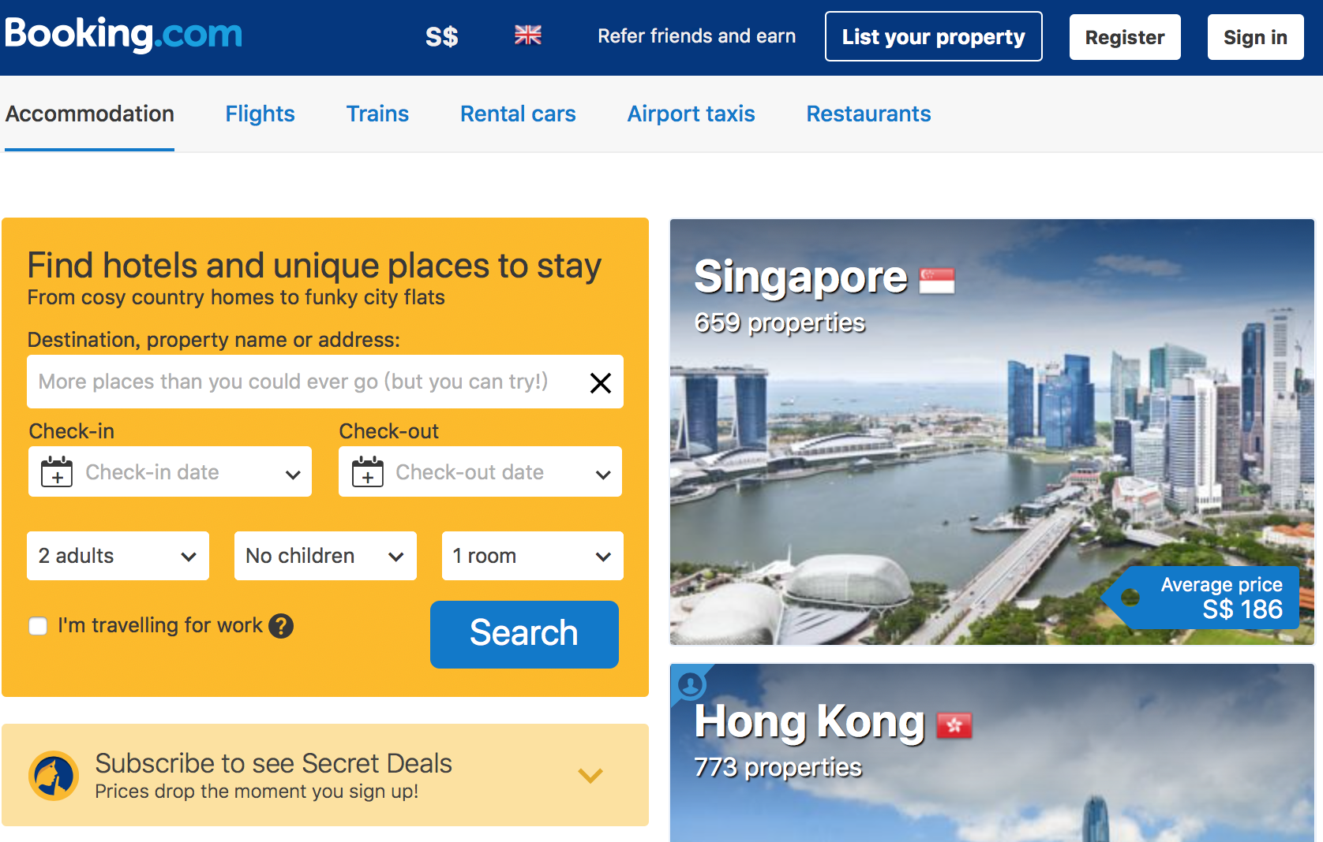
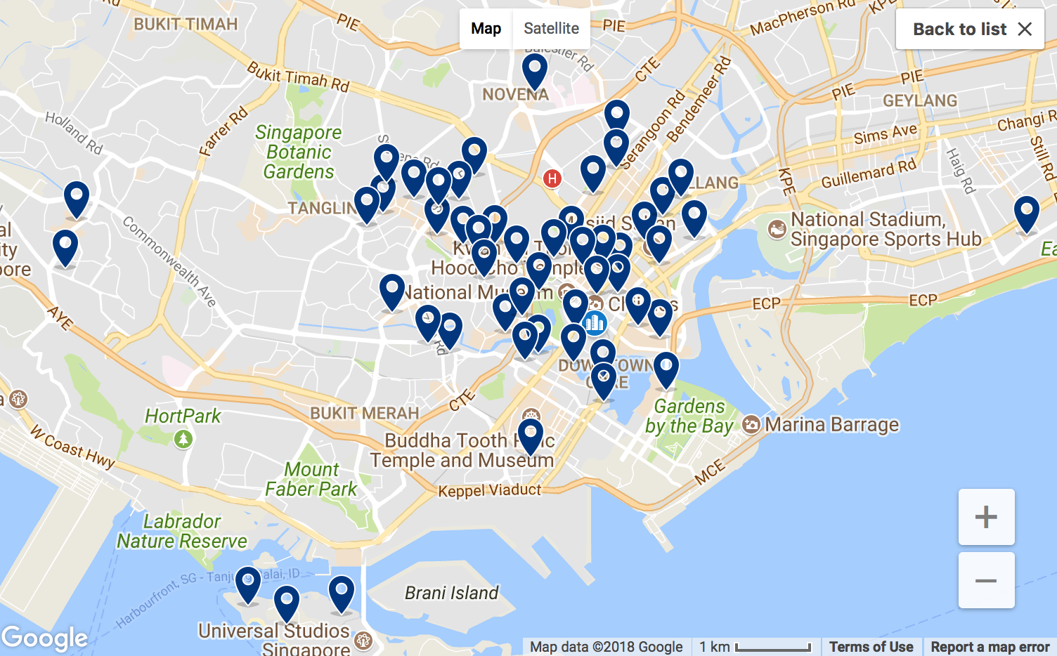
Case Study

Slide 8
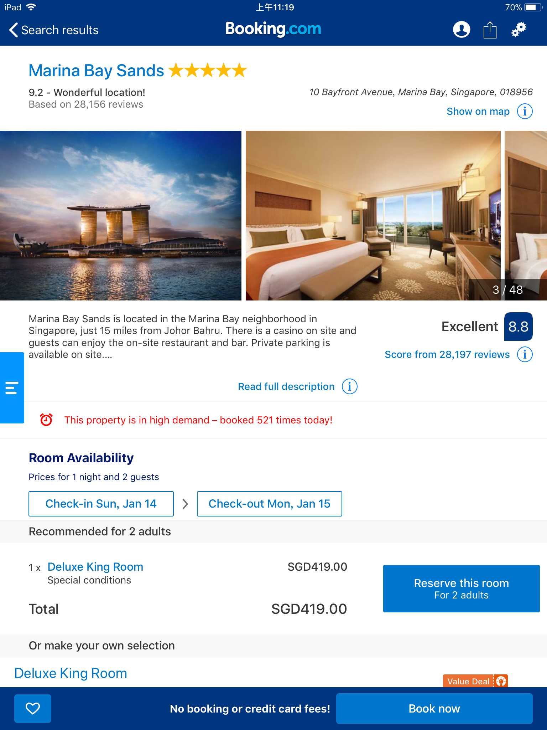
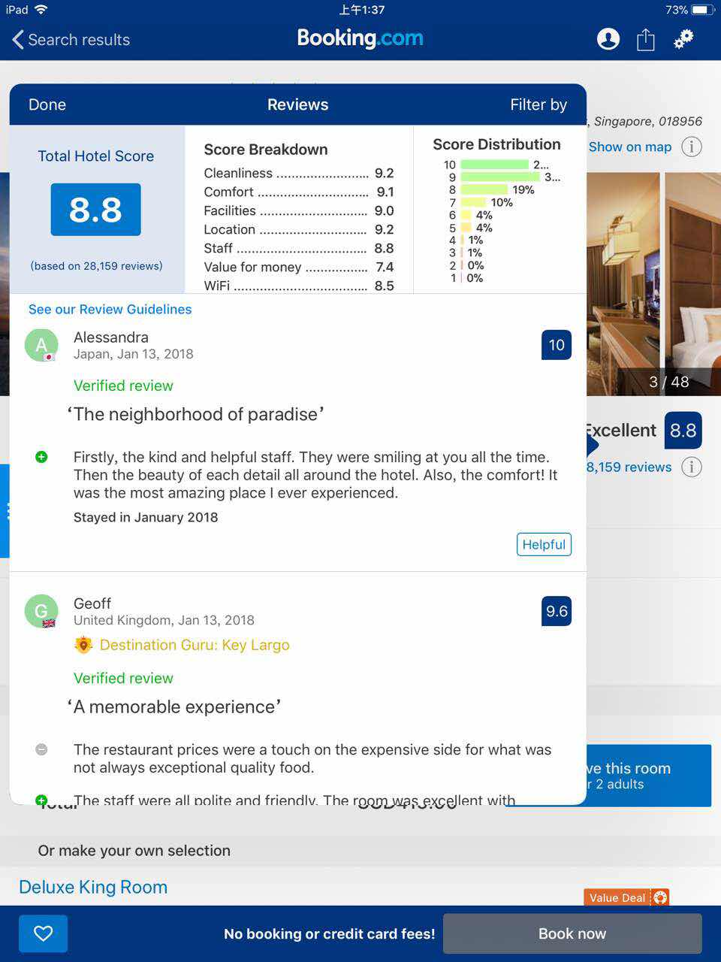


TEXT PRE-PROCESSING TEXT ANALYSIS

Slide 9
DATASET
Total 6,300 reviews covering 6 hotels:
5 STAR: Marina Bay Sands, Crowne Plaza Changi Airport
4 STAR: PARKROYAL on Beach Road, Siloso Beach Resort Sentosa
3 STAR: Ibis Singapore on Bencoolen, Destination Singapore Beach Road

Slide 10
Customer_ID | nationality | tags | score | Content | Content_detail
1 | Canada | <U+2022> Leisure trip<U+2022> Couple<U+2022> The Grand Club King Room<U+2022> Stayed 2 nights | 9.2 | “So, amazing in many ways but did not receive a personal treatment, however club lounge was good” | <U+B198>I was really surprised there was no turn down service, which is normally standard …..Stayed in December 2017
Trip type | #customer | Room type | #night | Submit way
leisure | couple | The Grand club king room | 2 | mobile
business | solo | Deluxe king room | 1

Slide 11
2.
Data Preparation

Slide 12
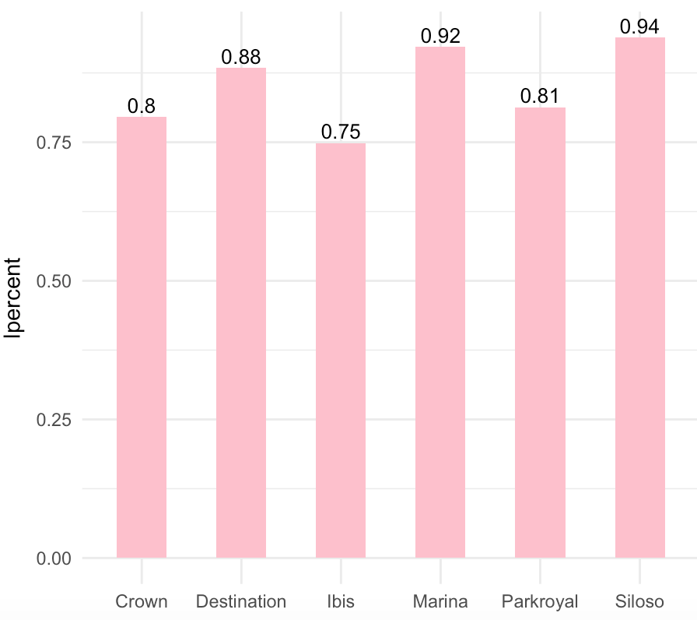
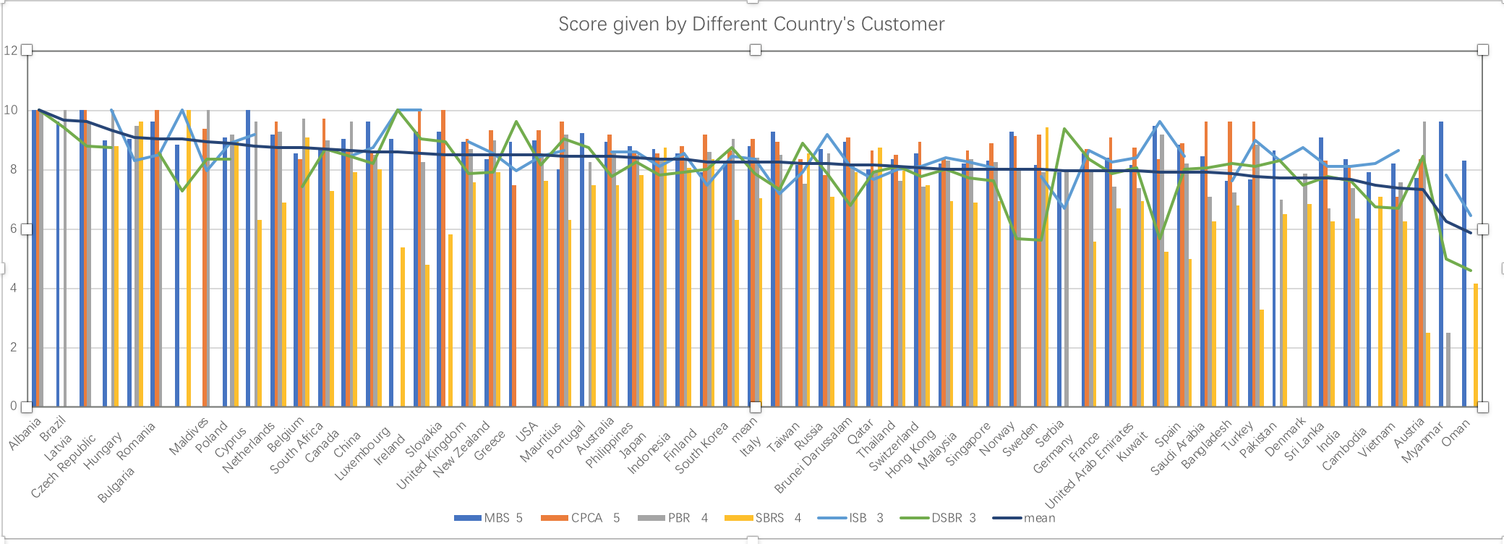
Leisure trip percentage

Slide 13
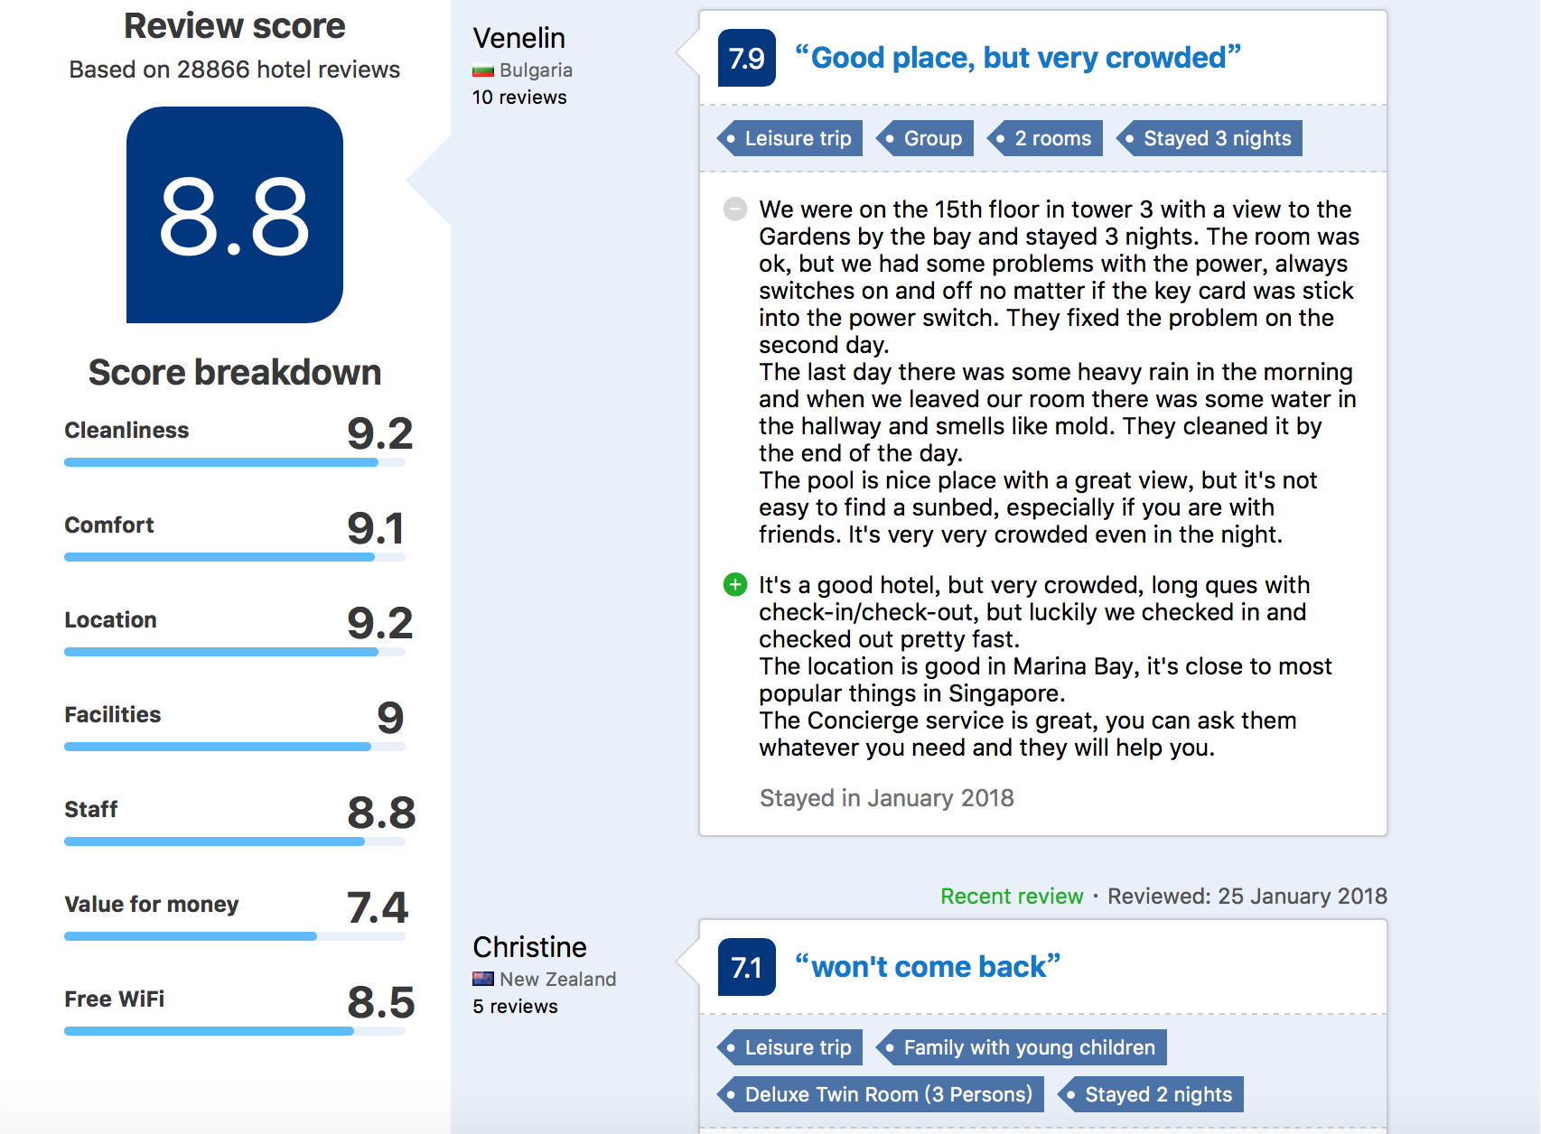
Importing text
Customer_ID | nationality | tags | score | Content | Content_detail
1 | Canada | <U+2022> Leisure trip<U+2022> Couple<U+2022> The Grand Club King Room<U+2022> Stayed 2 nights | 9.2 | “So, amazing in many ways but did not receive a personal treatment, however club lounge was good” | <U+B198>I was really surprised there was no turn down service, which is normally standard …..Stayed in December 2017
2 | Qatar | <U+2022> Leisure trip<U+2022> Couple<U+2022> Deluxe King Sky View<U+2022> Stayed 1 night<U+2022> Submitted via mobile | 7.5 | “Nice but missing quite a few small details youa<U+0080><U+0099>d expect with a five star.” | <U+B198>Overpriced in general<U+B200>Amazing view as expected and paid forStayed in January 2018
3 | … | … | … | … | …
Mining text data from website by R.
Write the data into csv text files which is easy to re-read into R for the later operation.

Slide 14
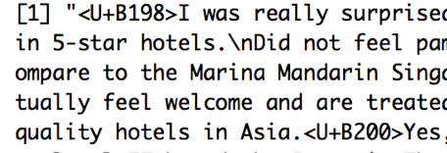
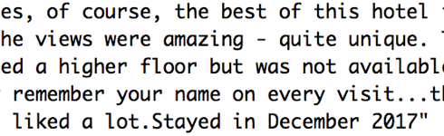
String operations
Remove html tags
Remove digit and punctuation

Slide 15
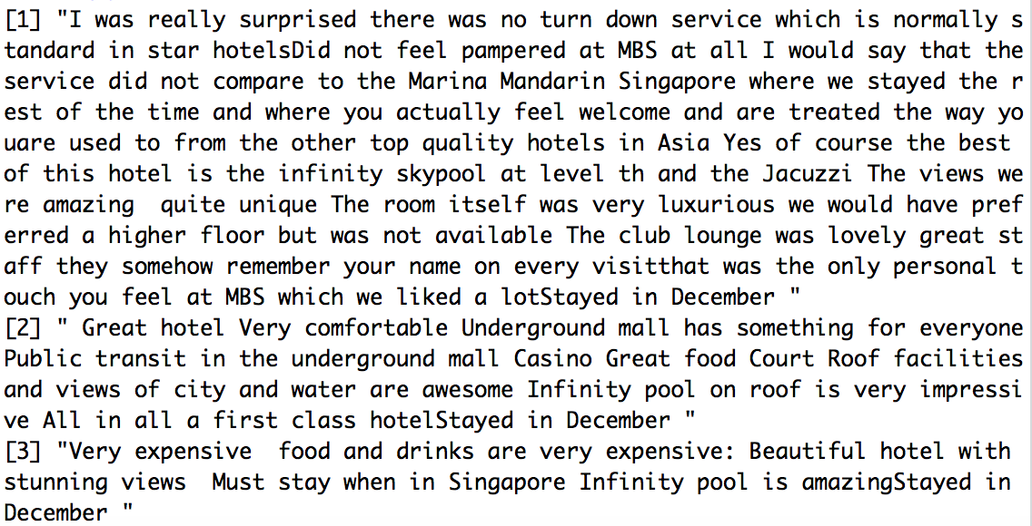
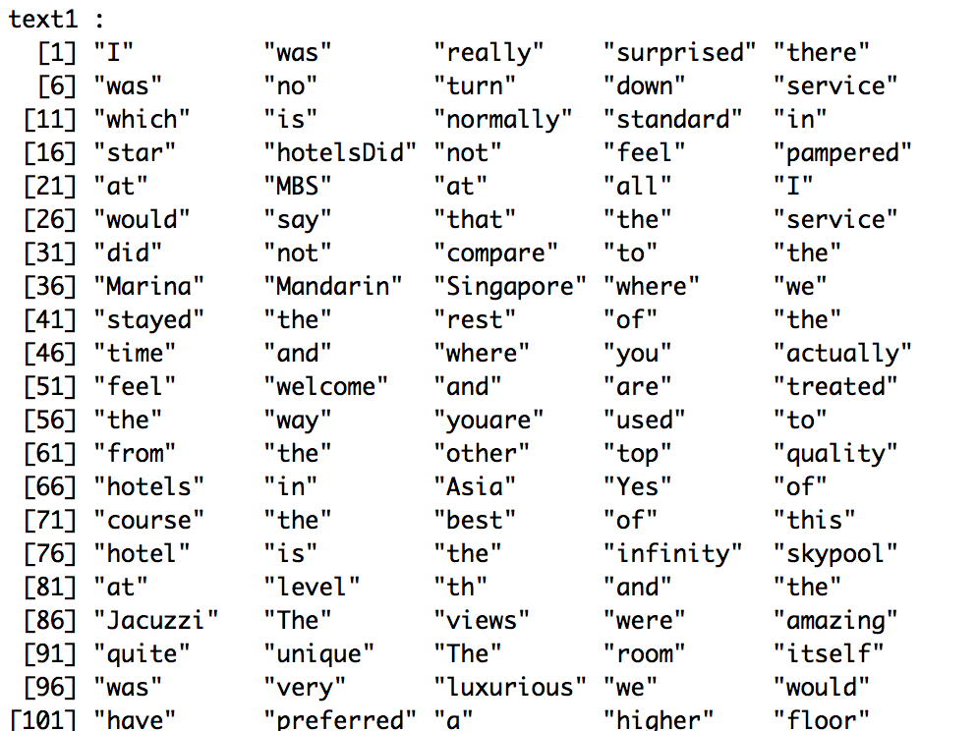
preprocessing
tokenization
Tokenization is the process of splitting a text into tokens.
splitting texts by words can mostly be done by word boundaries, such as white spaces, dots and commas.

Slide 16
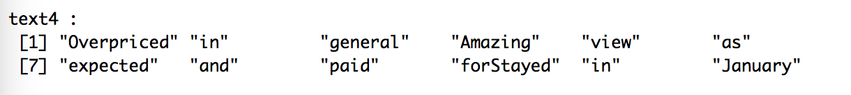
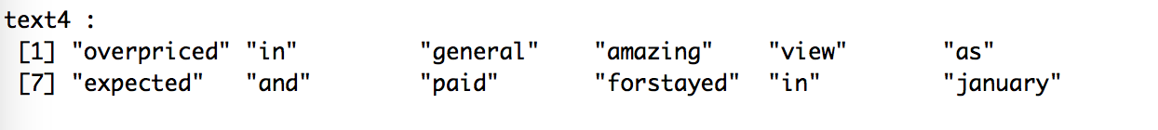
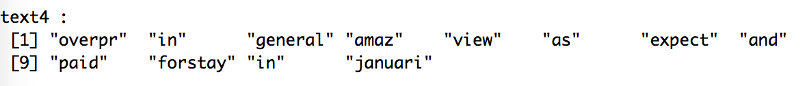
preprocessing
Normalization
transformation of words into a more uniform form.
Lowercasing
stemming
Transform it in to lower
Stemming to reduce the feature space

Slide 17
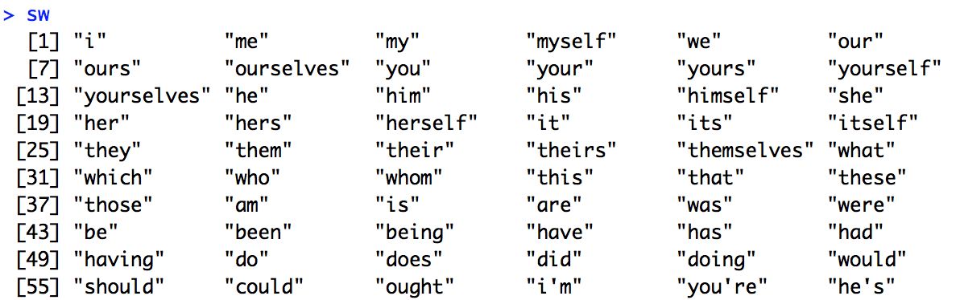
preprocessing
Removing stopwords
reduce the size of the data
reduce computational load
improve accuracy.

Slide 18
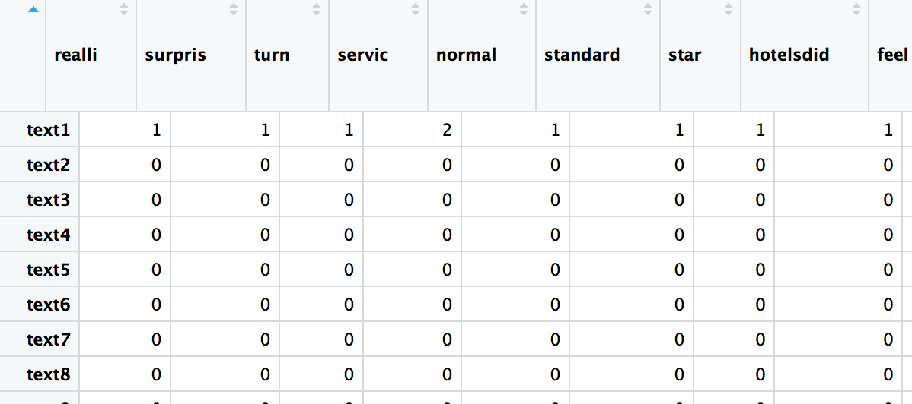
preprocessing
Document-term matrix
A DTM is a matrix in which rows aredocuments, columns are terms, and cells indicate how often each term occurred in each document.
Document-feature matrix of: 1,050 documents, 2,806 features (99.4% sparse).

Slide 19
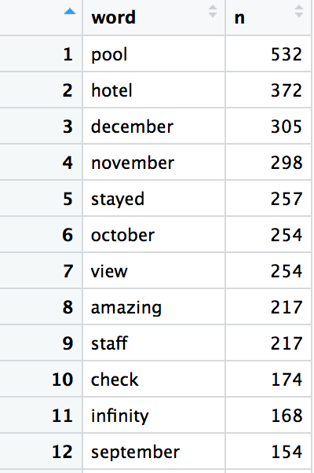
preprocessing
Calculate word count
Rank words according to frequency
using a threshold for minimum and maximum number (or proportion) of documents

Slide 20
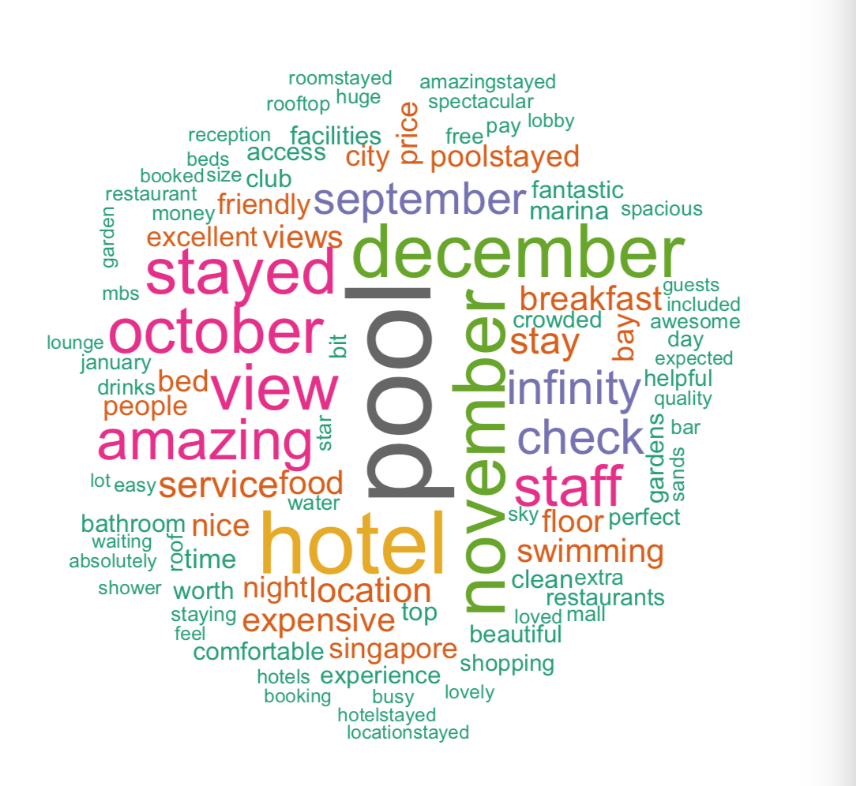
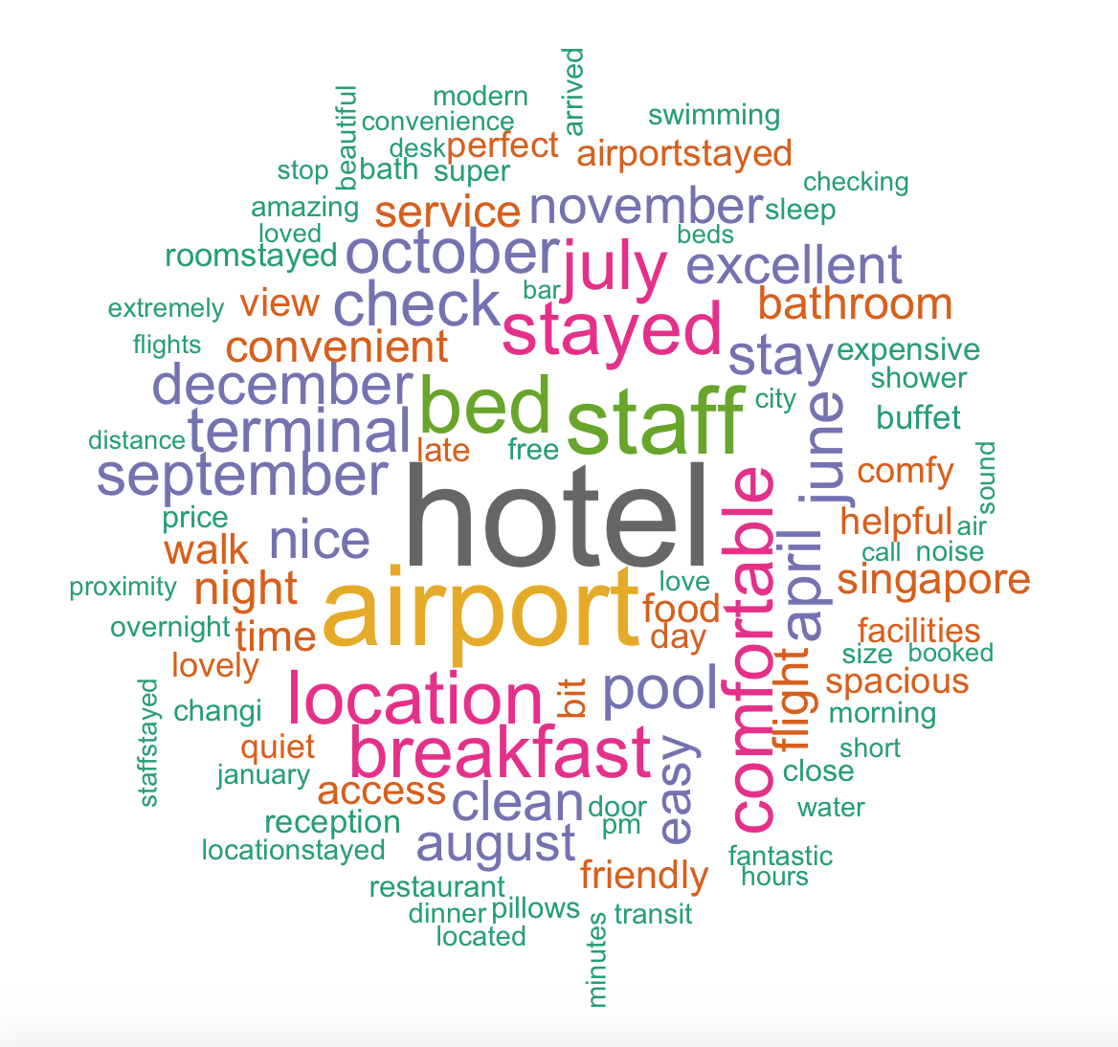
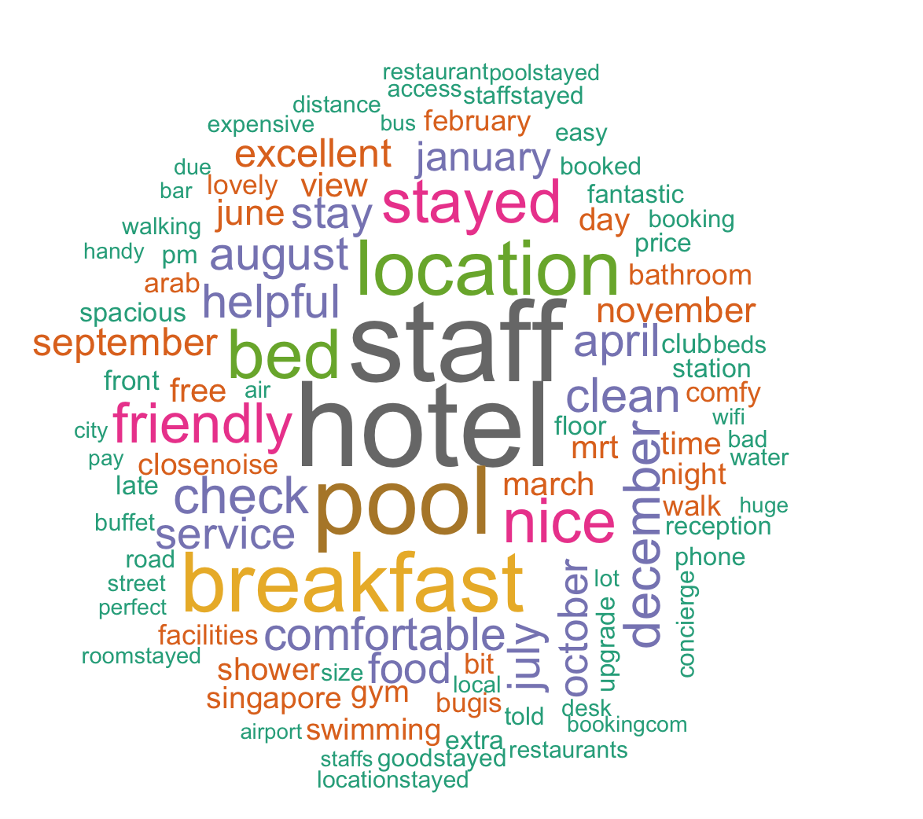
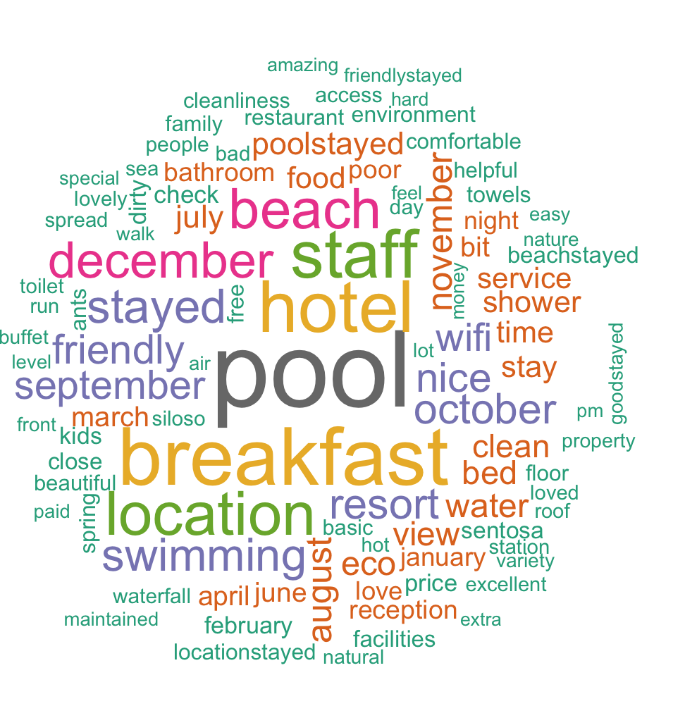
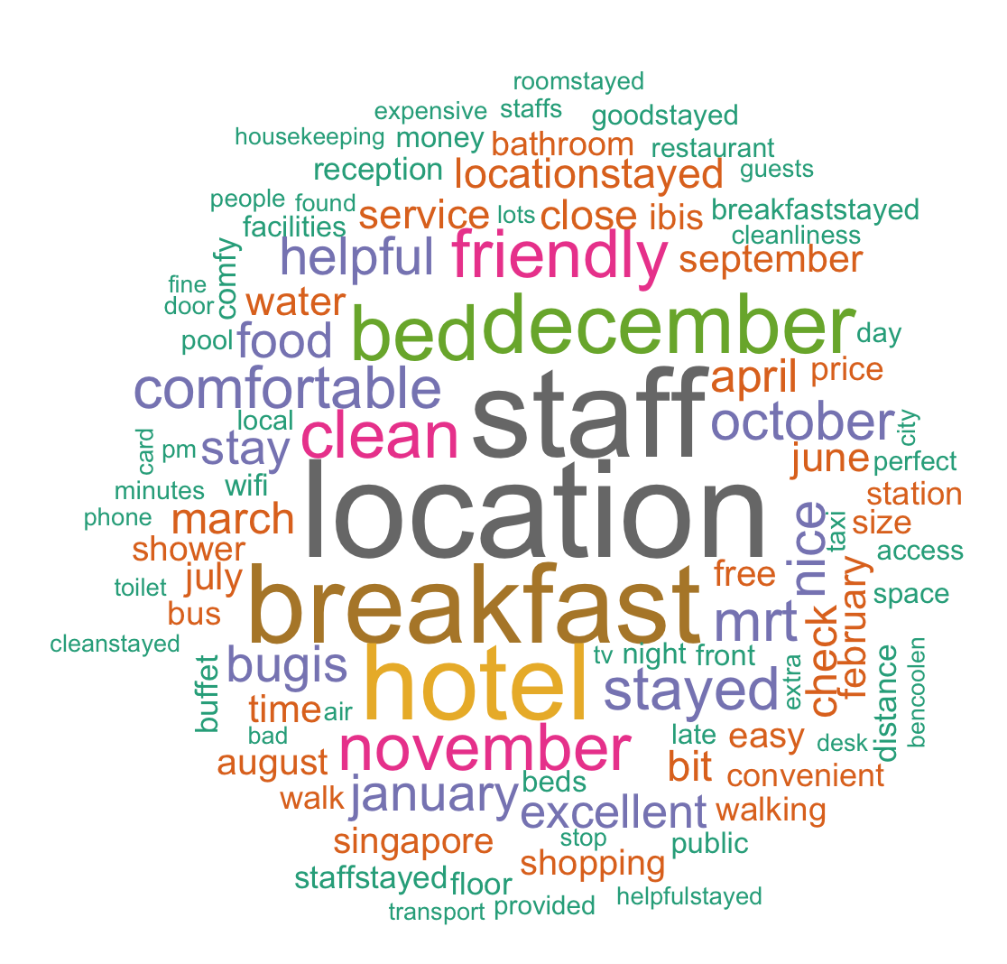
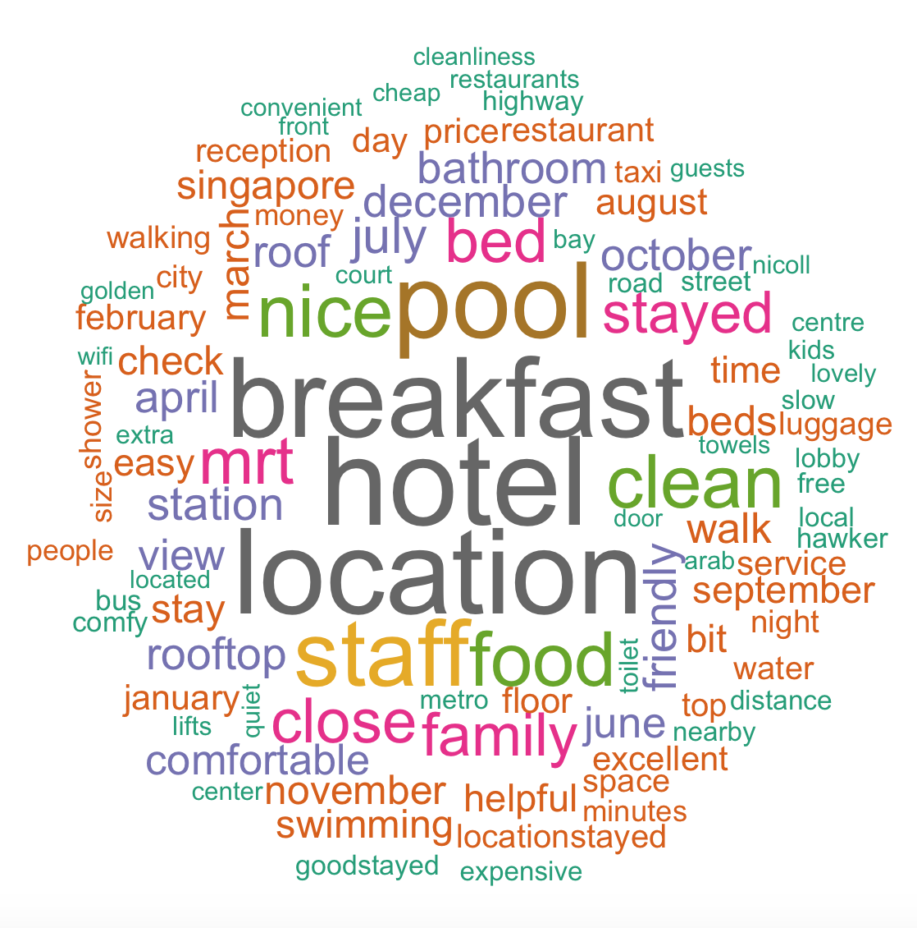
wordclouds
MBS ✨5
CPCA ✨5
PBR ✨4
SBRS ✨ 4
ISB ✨3
DSBR ✨3

Slide 21
Lexicon based Sentiment Analysis

Slide 22
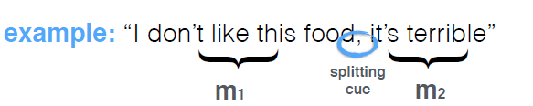
What are Lexicons?
SentiWordNet
http://sentiwordnet.isti.cnr.it
WordNet Affect
http://wndomains.fbk.eu/wnaffect.html
SenticNet
http://sentic.net
MPQA
http://mpqa.cs.pitt.edu
Lexical Resources
A lexicon is a collection of lexemes or a word database. A lexeme roughly corresponds to a set of words that are different forms of "the same word".
For example, English run, runs, ran and running are forms of the same lexeme.
The sentiment of a textual content depends on the sentiment of each microphase or lexemes which compose it
A microphase is built whenever a splitting cue is found in the text
Conjunctions, Adverbs and punctuations are used as Splitting cues.
Each word is provided a discrete sentiment score.

Slide 23
Packages in Sentiment Analysis
library(tidytetxt)
library(sentimentalanalysis)
library(syuzhet)
library(sentimentr)
Other Packages
library(tm)
library(wordcloud)
library(SnowballC)
library(rJava)
library(Rwordseg)
library(plyr)
library(wordcloud2)
The main structure for managing documents in tm is a so-called Corpus, representing a collection of text documents
This package can be used on English as well as Chinese text.

Slide 24
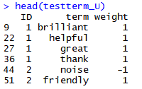
Filtering and Weighting
Each Word is provided with three different sentiment scores (positivity, negativity, objectivity). For Simplicity we have assigned a +1 to positive words, -1 to negative words and 0 to the neutral words.
Positive
Amazing
Eventful
Great
Nice
Trustworthy
Negative
Alarming
Contradiction
Hideousness
Provocative
Wasteful
Neutral
Again
Instead
Provided
Somebody
Whatever

Slide 25
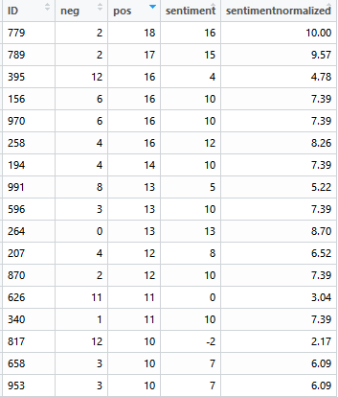
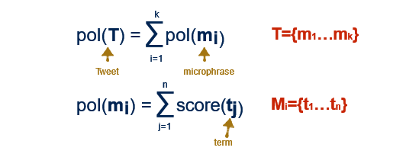
Counting and Sentiment Scoring
The sentiment of a Review depends on the sentiment of the terms which compose it.
ID | Review | Weight
2 | dusty | -1
2 | everywhere | 0
2 | friendly | 1
2 | lovely | 1
floor is dusty, there are ants everywhere The hotel is eco friendly which is lovely!

Slide 26
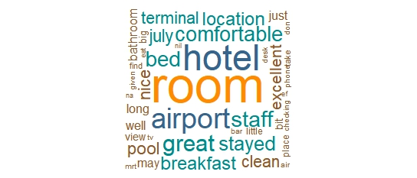
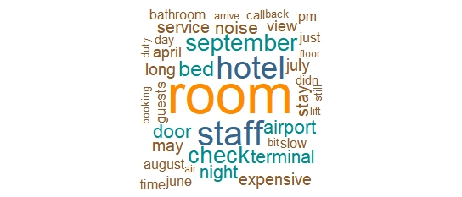
Positive vs Negative Reviews

Slide 27
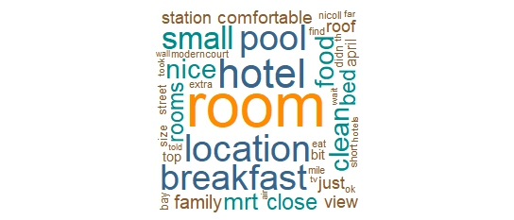
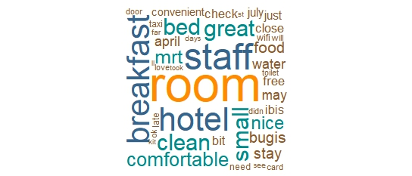
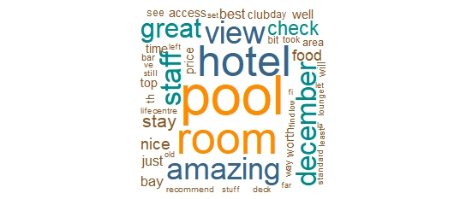
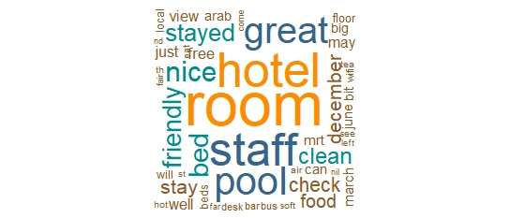
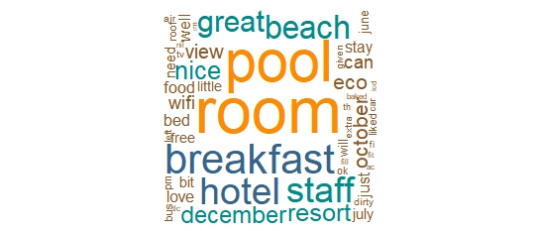
Let’s look at Positive Reviews
Crowne Plaza
Destination Singapore
Ibis Singapore
Marina Bay
ParkRoyal
Siloso Beach Resort

Slide 28
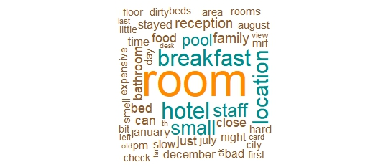
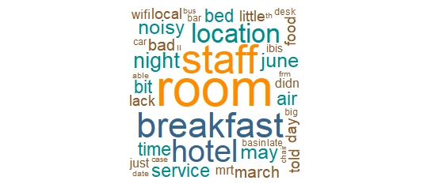
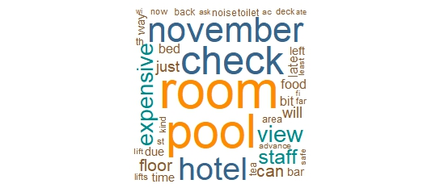
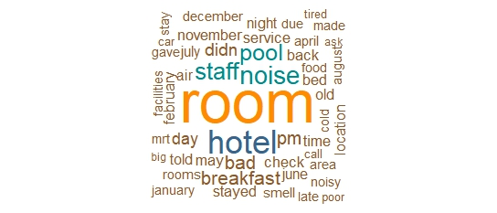
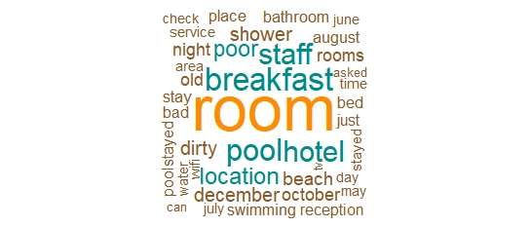
Let’s look at Negative Reviews
Crowne Plaza
Destination Singapore
Ibis Singapore
Marina Bay
ParkRoyal
Siloso Beach Resort

Slide 29
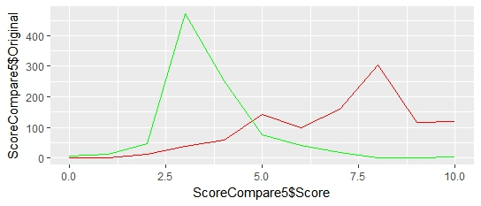
Original Score vs Sentiment Analysis
Original Score
Sentiment Analysis
Frequency
Score
Siloso Beach Resort

Slide 30
Two Factors Limiting Performance
Eg. :
Good
Great
Extraordinary
Dictionary
Level of sentiment differs for different words
Context
”The room could have been cleaner Carpet not vacummed and crumbs found around the video console area The location Stayed in January”
Negators appear ~20% of the time a polarized word appears in a sentence.
The algorithm cannot understand
7.1

Slide 31
R Package: sentimentr
Update Date:
2018-01-16
Description:
Quickly calculate text polarity sentiment at the sentence level and optionally aggregate by rows or grouping variable(s)
A dictionary lookup approach that tries to incorporate weighting for valence shifters

Slide 32
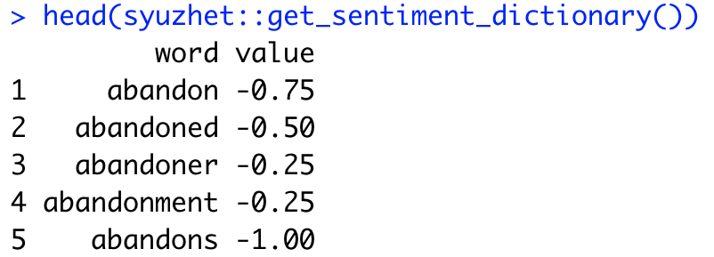
sentimentr: Dictionary
Uses a polarity table of words and their weights
Default polarity table is based on Jockers (2017) in syuzhet package.
You can create your own polarity table
Not restricted to -1 and +1

Slide 33
sentimentr: Valence Shifters
Valence shifters alter or intensify the meaning of polarizing words
Includes negators, amplifiers, de-amplifiers, and adversative conjunctions
An amplifier (intensifier) increases the impact of a polarized word. (e.g., "I really like it.”)
A de-amplifier (downtoner) reduces the impact of a polarized word (e.g., "I hardly like it.")

Slide 34
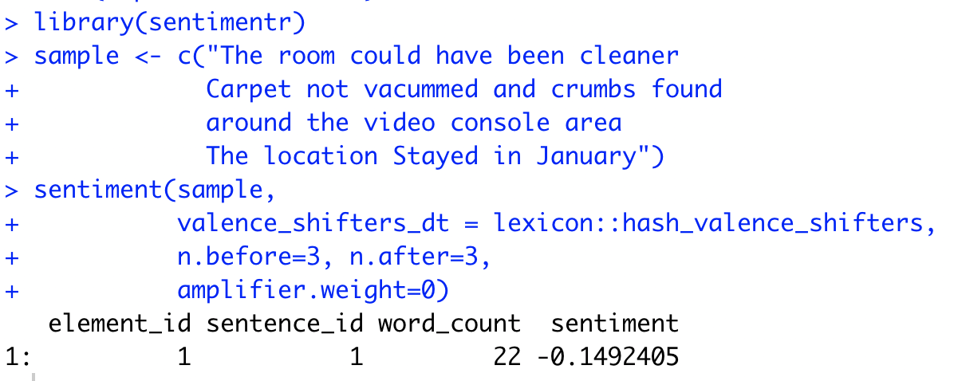

Slide 35
Supervised Sentiment Analysis

Slide 36
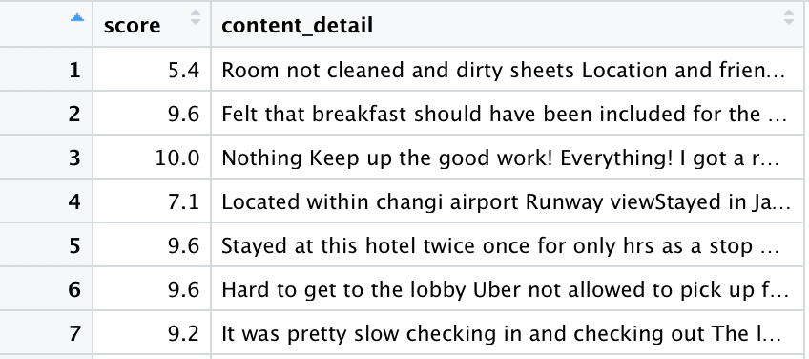
The Steps
Define the label
Classify scores as positive and negative
Use score directly
Data Preprocessing
Build a Bag-of-words linear model

Slide 37
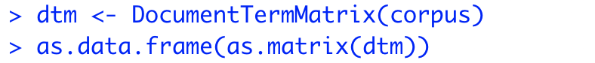
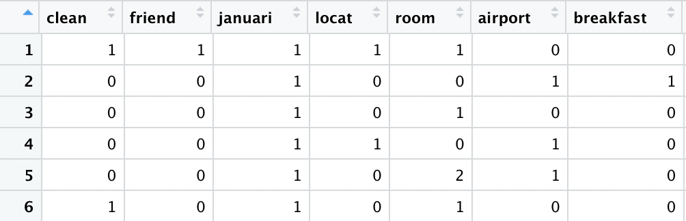
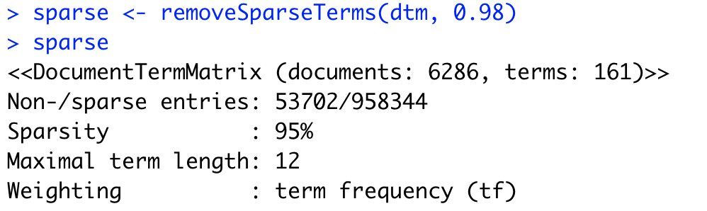
Data Preprocessing
R Package: tm
Inputs: content_detail
Prepare corpus
Lower-casing
Removing punctuations, stopwords, whitespace
Stemming
Covert to document term matrix
Remove unimportant terms
Notes:
we create a VectorSource, that is the input type for the Corpus function defined in the package tm
we want terms that appear in at least 2% of the documents

Slide 38
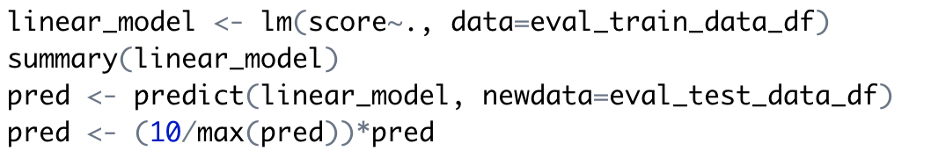


Linear Regression
Split into train and test data
Build a linear regression model
Predict test scores and normalization
Comparison
Notes:
we create a VectorSource, that is the input type for the Corpus function defined in the package tm
we want terms that appear in at least 2% of the documents

Slide 39
Remarks
Limiting factors
Lack to training data
Score and sentiment are not perfectly correlated
Model is simple
Linguistics is complicated
Further improvement
Give only positive or negative label to data
More complicated algorithms based on larger data set

Slide 40
Topic modeling

Slide 41
Topic modeling
® Clustering method
® Latent Dirichlet allocation (LDA):
- treats each document as a mixture of topics
e.g.:in a two-topic model we could say “Document 1 is 90% topic A and 10% topic B, while Document 2 is 30% topic A and 70% topic B.
- treats each topic as a mixture of words

Slide 42




Objective:
Four novels with chapters unlabeled: we don’t know what words might distinguish them into groups. We’ll thus use topic modeling to discover how chapters cluster into distinct topics, each of them (presumably) representing one of the books
Four novels: Twenty Thousand Leagues under the Sea / The War of the Worlds / Pride and Prejudice / Great Expectations
1
2
Unlabeled chapters
Clustering
4 topics
3
4

Slide 43
STEPS
- Load the books -> Split into chapters
- Split into words -> remove stop words -> word counts
- LDA on chapters (clustering topics)
- Per-document classification (check the clustering result)
Packages
gutenbergr: loading books
topicmodels: modeling topics
stringr: deal with string
dplyr: operations on tables or dataframe
wordcloud2: draw word cloud
ggplot2: draw pictures
tidytext/tidyr: tidying model objects

Slide 44



STEPS
1. Load the books -> split into chapters
2. Split into words / remove stop words/ word counts

Slide 45


STEPS
3. LDA on chapters (clustering 4 topics):
Use wordcounts in each chapter to model 4 topics
- Find per-topic-per-word probabilities (beta)

Slide 46


- Find Top 5 keywords for each topic:

Slide 47





Wordcloud for top 100 words in four novels
Using pacakage “wordcloud2”
The input is data frame including word and frequency:
>wordcloud2(top100TWW,…)
The War of the Worlds
Twenty Thousand Leagues under the Sea
Great Expectations
Pride and Prejudice

Slide 48



STEPS
4.2 find classification on topics for all chapters
4. Per-document classification
4.1 find per-document-per-topic probabilities (gamma)
4.3 find the misclassified chapters

Slide 49

STEPS
4.4 Assgin each word in documents to topics
4.5 Find words which are most easily to be misclassified

Slide 50
Summary
Sentiment Analysis
- unsupervised: dictionary-based
- supervised (text with label): classification
Topic modeling

Slide 51
Thank you!

